Slide 1
WAP (Wireless Application Protocol)
By:
Dr. Vipin Kumar

Slide 2
Wireless Application Protocol (WAP)
WAP is an open, global specification that empowers mobile users with wireless devices to easily access and interact with internet information and services instantly.
WAP is a “standard” created by wireless and Internet companies to enable Internet access from a cellular phone
wapforum.org:
  co-founded by Ericsson, Motorola, Nokia, Phone.com
  450 members in 2000, comprise of Handset manufacturers, Wireless service providers, ISPs, Software companies in the wireless industry
  Goals
    deliver Internet services to mobile devices
    enable applications to scale across a variety of transport options and device types
    independence from wireless network standards
    GSM, CDMA IS-95, TDMA IS-136, 3G systems (UMTS, W-CDMA)

Slide 3
WAP: Main Features
Browser
  “Micro browser”, similar to existing web browsers
Markup language
  WML is the markup language for WAP
  WAP is similar to HTML (but not HTML), adapted to mobile devices
Script language
  Similar to Javascript, adapted to mobile devices
Gateway
  Transition from wireless to wired world
Server
  “Wap/Origin server”, similar to existing web servers
Protocol layers
  Transport layer, security layer, session layer etc.
Telephony application interface
  Access to telephony functions

Slide 4
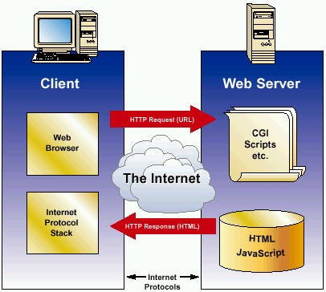
Internet Model
HTML
HTTP
TLS/SSL
TCP/IP

Slide 5

WAP Architecture
Client
Web Server
WAP Gateway
WML
WML Encoder/
Decoder
CGI
Scripts
etc.
WML-Script
WSP/WTP
HTTP
WMLScript
Compiler
WML Decks
with WML-Script
WTAI
Protocol Adapters
Content
Etc.
Source: WAP Forum

Slide 6

WAP Application Server
Client
WAP Application Server
WML
WML Encoder
Application
Logic
WML-Script
WSP/WTP
WMLScript
Compiler
WML Decks
with WML-Script
WTAI
Protocol Adapters
Content
Etc.
Source: WAP Forum

Slide 7
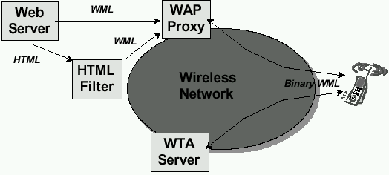
WAP Architecture
Key Components
Another look
Origin/Web Server
WAP Gateway/Proxy
WAP Protocol Stack
Micro Browser
WML/WML Script
Transcoders
WTA
Source: WAP Forum

Slide 8
WAP Specifies
Wireless Application Environment
  WML Microbrowser
  WMLScript Virtual Machine
  WMLScript Standard Library
  Wireless Telephony Application Interface (WTAI)
  WAP content types
Wireless Protocol Stack
  Wireless Session Protocol (WSP)
  Wireless Transport Layer Security (WTLS)
  Wireless Transaction Protocol (WTP)
  Wireless Datagram Protocol (WDP)
  Wireless network interface definitions

Slide 9
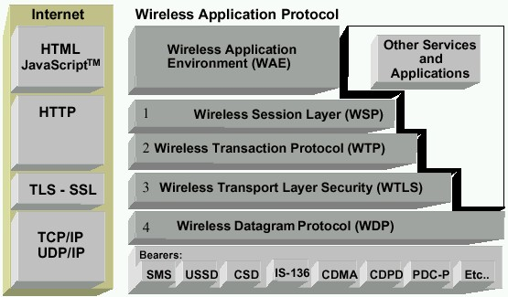
WAP Protocol Stack
Runs on top of WDP
Provided lightweight X-oriented service
Unreliable 1-way request
Reliable 1-way/2-way req./response
Micro Browser (WML, WML Script, WTA, WTAI)
Lightweight SSL
Uses WIM/PKI-Cards
Datagram service on different bearers
Convergence between bearer services
Different Wireless Tech.
Source: WAP Forum

Slide 10
WAE (Wireless Application Environment)
WAE (Wireless Application Environment): is a general purpose application environment based on a combination of WWW and MTA.
WAE includes a micro-browser that contain the following functionality:
  Wireless Markup Language(WML).
  WMLScript.
  Wireless Telephony Application (WTA, WTAI)
  WTA: telephone services, such as call control, phone book etc.
  Content Formats

Slide 11
WSP (Wireless Session Protocol)
WSP (Wireless Session Protocol): provides the application layer of WAP with a consistent interface for two session services.
  One connection oriented services
  Second connection less services
WSP consist services suited for browsing applications (WSP/B)
WSP/B provides following functionality:
  Provides HTTP 1.1 functionality
  Supports session management, security, etc.

Slide 12
WTP (Wireless Transaction Protocol)
WTP (Wireless Transaction Protocol): runs on top of a datagram services and provides as light weight transaction oriented protocol that is suitable for implementation in “thin” clients( Mobiles)
  Provides reliable message transfer mechanisms
  Based on ideas from TCP/RPC

Slide 13
WTLS (Wireless Transport Layer Security)
WTLS (Wireless Transport Layer Security) is based upon the industry standard transport layer security (TLS) protocol, formerly known as Secure Sockets Layer (SSL)
Provides:
  data integrity
  privacy
  Authentication
  Denial-of-service protection

Slide 14
WDP (Wireless Datagram Protocol)
WDP (Wireless Datagram Protocol):
  Provides transport layer functions
  Based on ideas from UDP

Slide 15
Bearers
WAP protocols are designed to operate over a variety of different bearer services (CDMA, GSM, WCDMA, etc.) including short message, circuit-switched data, and packet data.

Slide 16
WHY WAP?
Wireless networks and phones
  have specific needs and requirements
  not addressed by existing Internet technologies
WAP
  Enables any data transport
    TCP/IP, UDP/IP, GUTS (IS-135/6), SMS, USSD.
  Optimizes the content and air-link protocols
  Utilizes plain Web HTTP 1.1 servers
    leverages existing development methodologies
    utilizes standard Internet markup language technology (XML)
    all WML content is accessed via HTTP 1.1 requests
  WML UI components map well onto existing mobile phone user interfaces
    no re-education of the end-users
    leveraging market penetration of mobile devices
  Several modular entities together form a fully compliant Internet entity

Slide 17
Why is HTTP/HTML not enough?
Big pipe - small pipe syndrome
Internet
Wireless network
HTTP/HTML
WAP
<HTML>
<HEAD>
<TITLE>NNN Interactive</TITLE>
<META HTTP-EQUIV="Refresh" CONTENT="1800, URL=/index.html">
</HEAD>
<BODY BGCOLOR="#FFFFFF" BACKGROUND="/images/9607/bgbar5.gif" LINK="#0A3990" ALINK="#FF0000" VLINK="#FF0000" TEXT="000000" ONLOAD="if(parent.frames.length!=0)top.location='http://nnn.com';">
<A NAME="#top"></A>
<TABLE WIDTH=599 BORDER="0">
<TR ALIGN=LEFT>
<TD WIDTH=117 VALIGN=TOP ALIGN=LEFT>
<WML>
<CARD>
<DO TYPE="ACCEPT">
<GO URL="/submit?Name=$N"/>
</DO>
Enter name:
<INPUT TYPE="TEXT" KEY="N"/>
</CARD>
</WML>
Content encoding
<HTML>
<HEAD>
<TITLE>NNN Interactive</TITLE>
<META HTTP-EQUIV="Refresh" CONTENT="1800, URL=/index.html">
010011010011110110010011011011011101010010011010
Source: WAP Forum

Slide 18
WAE: Logical Model
Origin Servers
Gateway
Client
Method proxy
WTA
user agent
web
server
response
with
content
encoded
response
with
content
Push proxy
WML
user agent
other content
server
push
content
encoded
push
content
encoders
&
decoders
other
WAE
user agents
request
encoded
request

Slide 19
WTA Logical Architecture
other telephone networks
WTA Origin Server
WML
Scripts
Client
mobile
network
WTA
user agent
WTA & WML
server
WML
decks
WAE
services
WTA
services
WAP Gateway
encoders
&
decoders
network operator
trusted domain
other WTA
servers
third party
origin servers
firewall
Source: Schiller

Slide 20
?
Thank You

